Slide 1
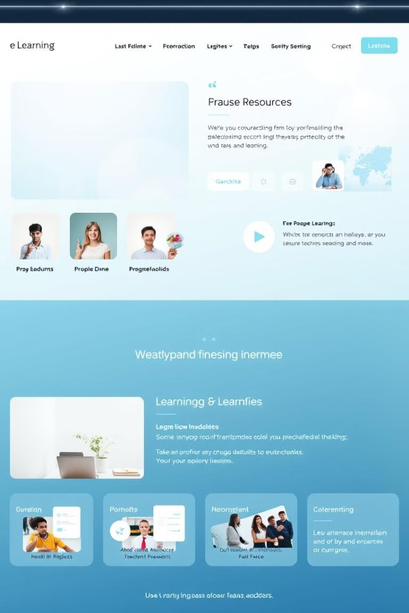

Infosys Springboard 5.0 E-Learning Platform
Welcome to our presentation on the E-Learning Platform Project. We will delve into its key features, development process, and successful outcomes.

Slide 2
Team 3
Mentor : Sanjeev Gone
Team Members:
Adarsh Patil
Pricilla Ruby
Sahana L
Sane Navya
Md Rasel Saikat Ul Hoque

Slide 3
Introduction
The E-Learning System is an online platform designed to offer effortless access to virtual education for learners and professionals.
Developed with a powerful technology stack that includes Angular for the user interface, Spring Boot for the server-side logic, and MySQL for data storage, the system supports user authentication, role-specific features, and course administration.
Featuring role-based access control, the platform delivers personalized experiences tailored to the needs of students, instructors, and administrators.
The solution prioritizes scalability, secure information management, and an intuitive interface to address the increasing need for adaptable and effective digital learning platforms.

Slide 4
Objectives and Scope
Objectives
Scope
The system emphasizes scalability, secure data handling, and a user-friendly interface, aiming to meet the growing demand for flexible and efficient e-learning solutions.
The project encompasses the development of a comprehensive e-learning platform including course creation, content management, learner enrollment, and progress tracking features.

Slide 5

Key Milestones and Timeline
We established a structured timeline for the development of the E-Learning Platform. Each phase involved specific deliverables and milestones.

Slide 6

Key Milestones and Timeline
1
2
3
4
Milestone 1
Milestone 2
Milestone 3
Milestone 4
User authentication and course availability management.
Course booking and scheduling.
Course Information management and user dashboard development.
Notification system and admin dashboard implementation.

Slide 7

Requirements Specification
Hardware Requirements
Software Requirements
Angular
Quad-core Processor 8 GB RAM or more
Spring Boot
Java 21
100 GB SSD
MySQL
Stable Internet (1 Mbps+)
IntelliJ IDEA/VSCode
Browsers (Chrome, Firefox, Safari)
Git
Maven/Gradle
Postman

Slide 8
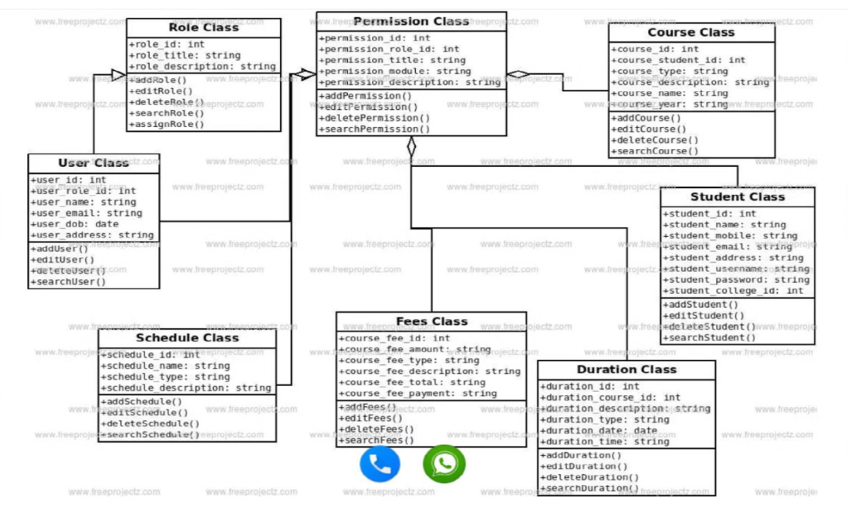
Class Diagram

Slide 9
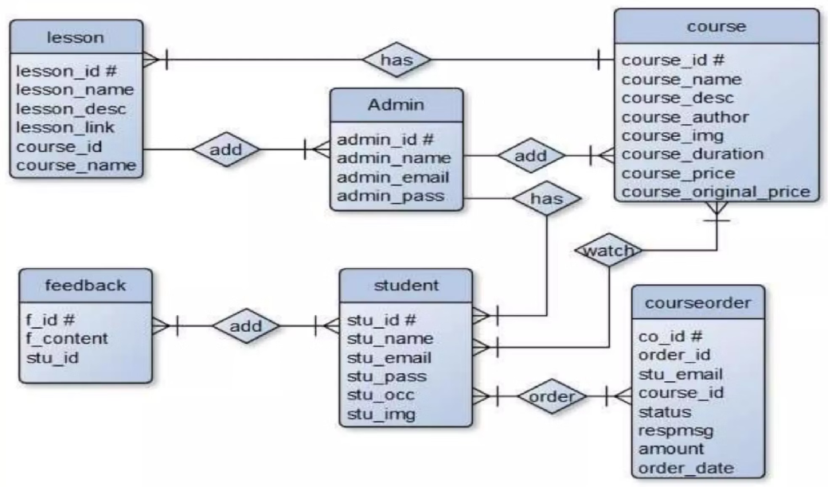
Entity Relationship Diagram and Database Design

Slide 10
Key Achievements
Key Deliverables
Successfully implemented secure user authentication and role-based dashboards for admins, professors and students.
Fully Functional Modules:
User Authentication and Registration
Developed a dynamic course management system with course recommendations.
Course Availability and Feedback Management Course Information
Integrated automated email/SMS notifications for user registration.
Admin Dashboard
Database Design: Comprehensive schemas for users, courses, schedules, and feedback.
Delivered an intuitive admin dashboard for managing users, courses, and system settings.
Front-End Interface: Responsive UI built with Angular, including form validations and dashboards.
Back-End Functionality: Robust Spring Boot APIs for seamless system operations.

Slide 11
Challenges Faced
Ensuring secure login, role-based access, and data protection.
Handling increased user load and growing data without affecting performance.
Designing a user-friendly and responsive interface across different devices.
Managing complex relationships between courses, students, and schedules.
Solutions Implemented
Implemented Spring Security with encryption, role-based access control, and secure password storage.
Used a scalable MySQL database with optimized queries and deployed the backend on a high-performance server.
Built a responsive Angular-based UI with consistent navigation, form validations, and graphical course progress representation.
Designed normalized SQL schemas and implemented effective indexing for faster data retrieval.

Slide 12
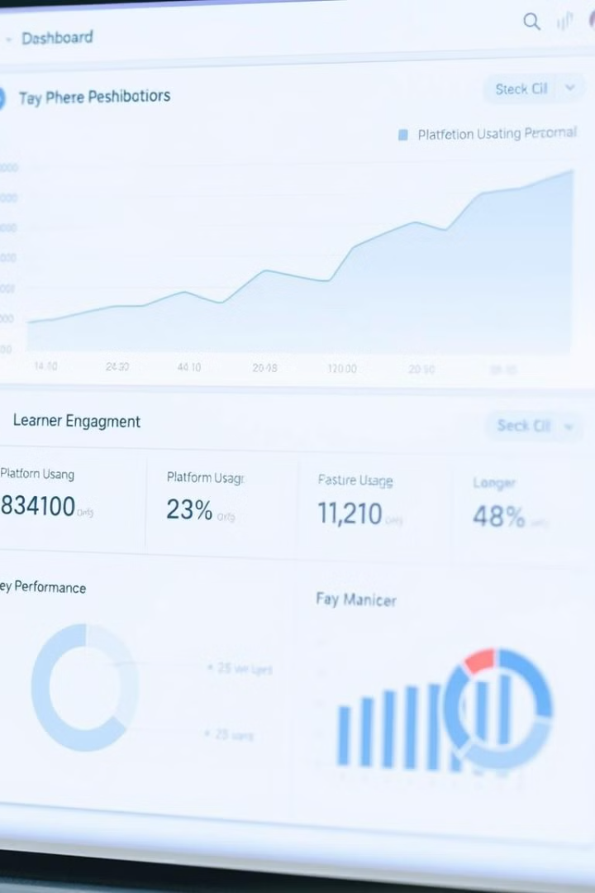





Results
Enhanced User Experience
Delivered a responsive and user-friendly web interface, enabling seamless navigation for students and administrators.
Efficient Course Management
Successfully implemented a robust course availability and booking.
Scalable System Architecture
Designed a scalable backend capable of handling high user traffic and data volume without performance degradation.
Improved Engagement
Notifications and progress tracking fostered higher engagement and timely course completion rates.
Secure and Reliable Platform
Ensured data security and system reliability through robust authentication and error-handling mechanisms.

Slide 13
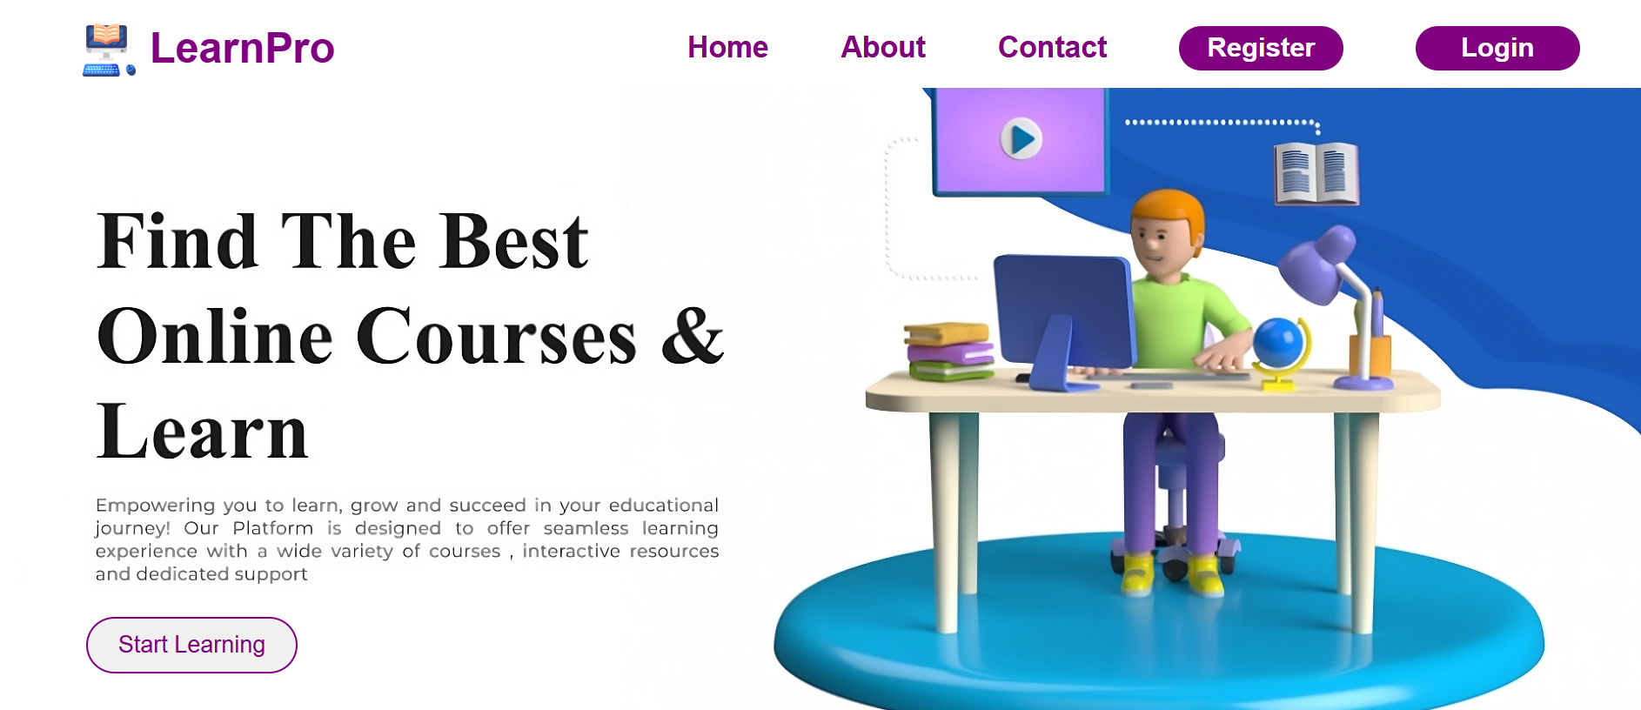

Slide 14
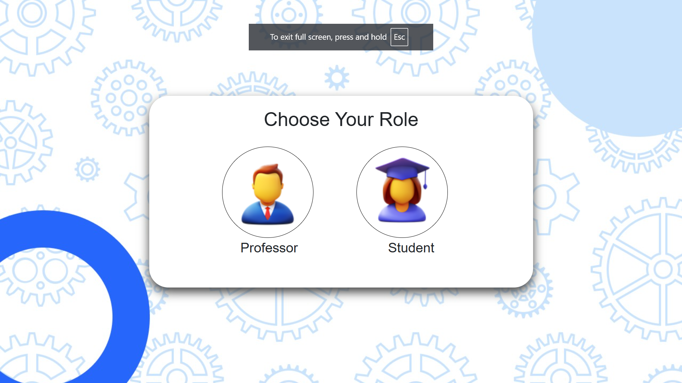

Slide 15
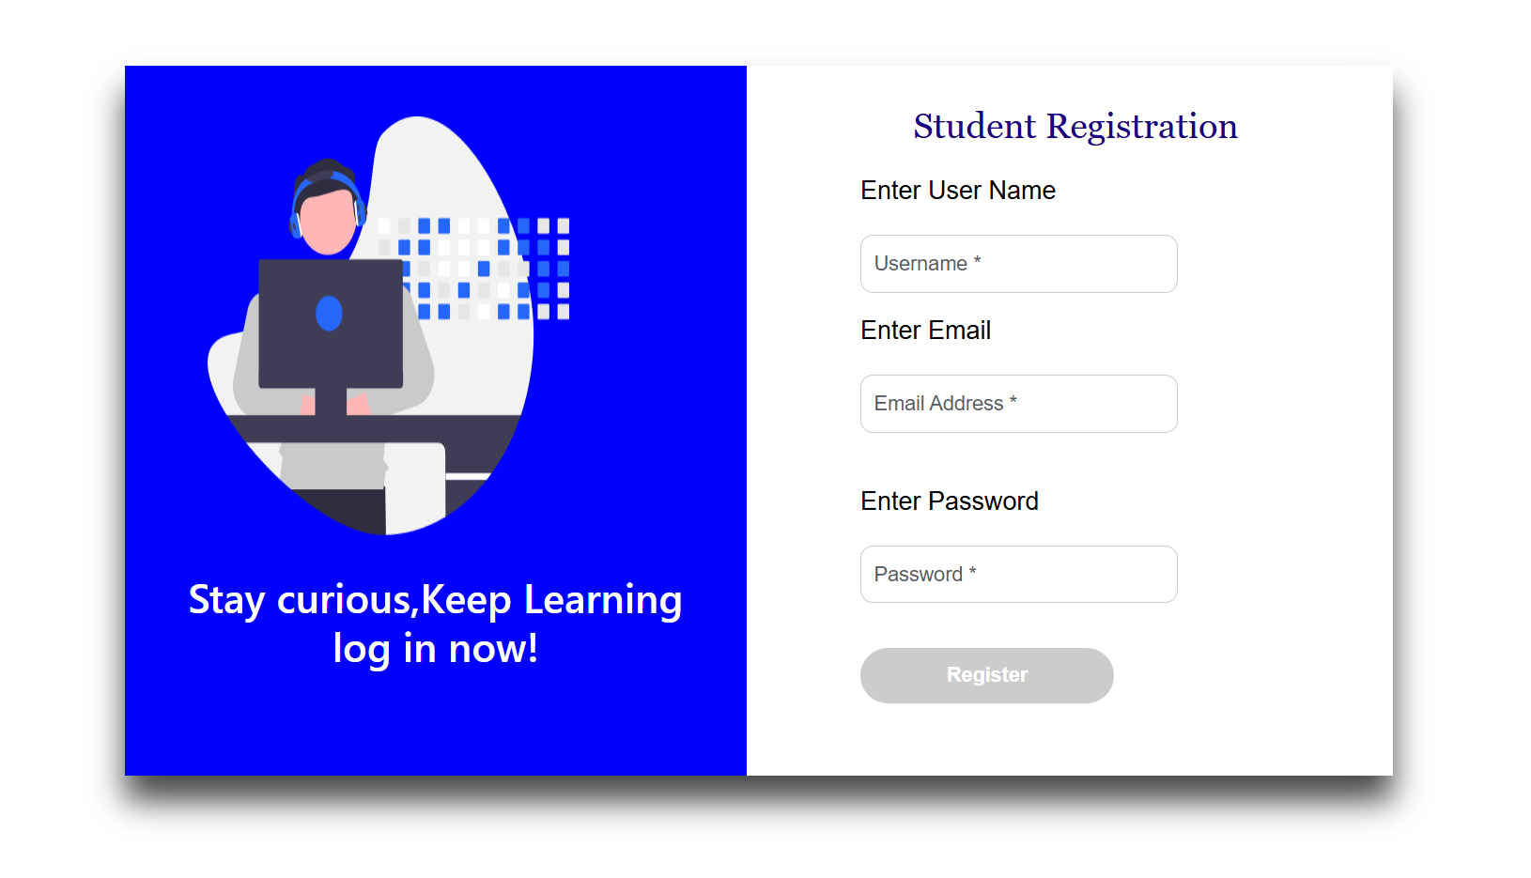

Slide 16
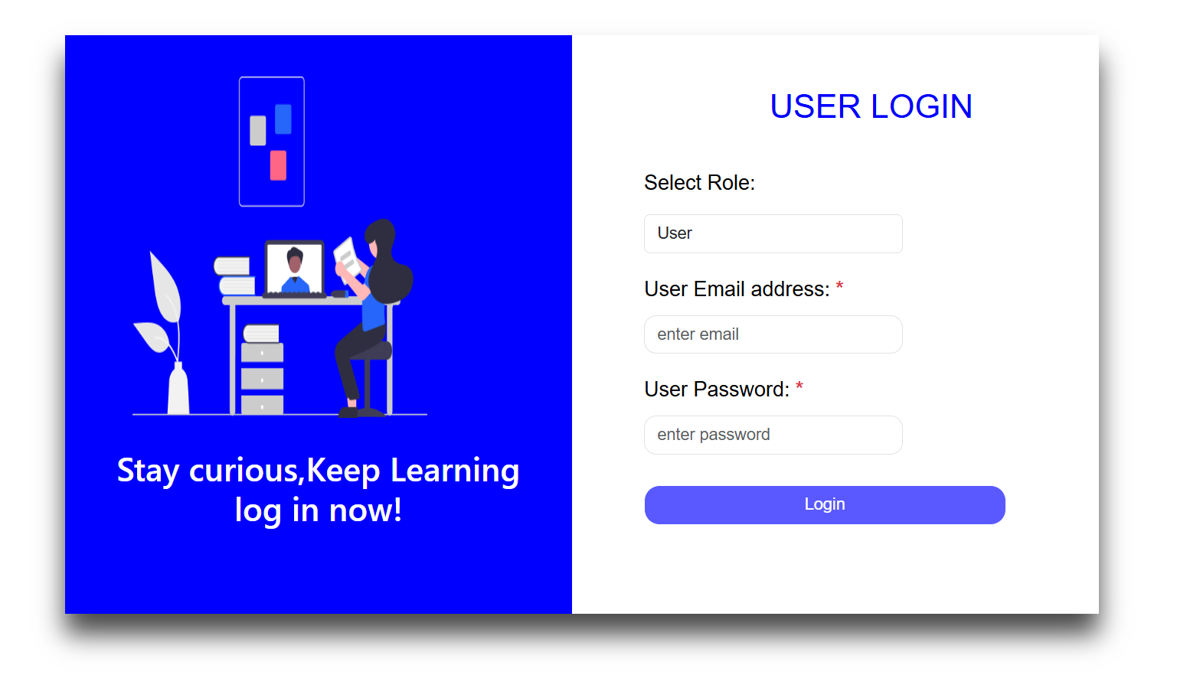

Slide 17
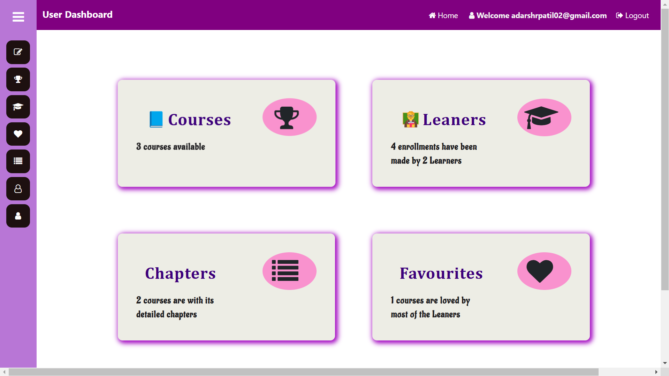

Slide 18
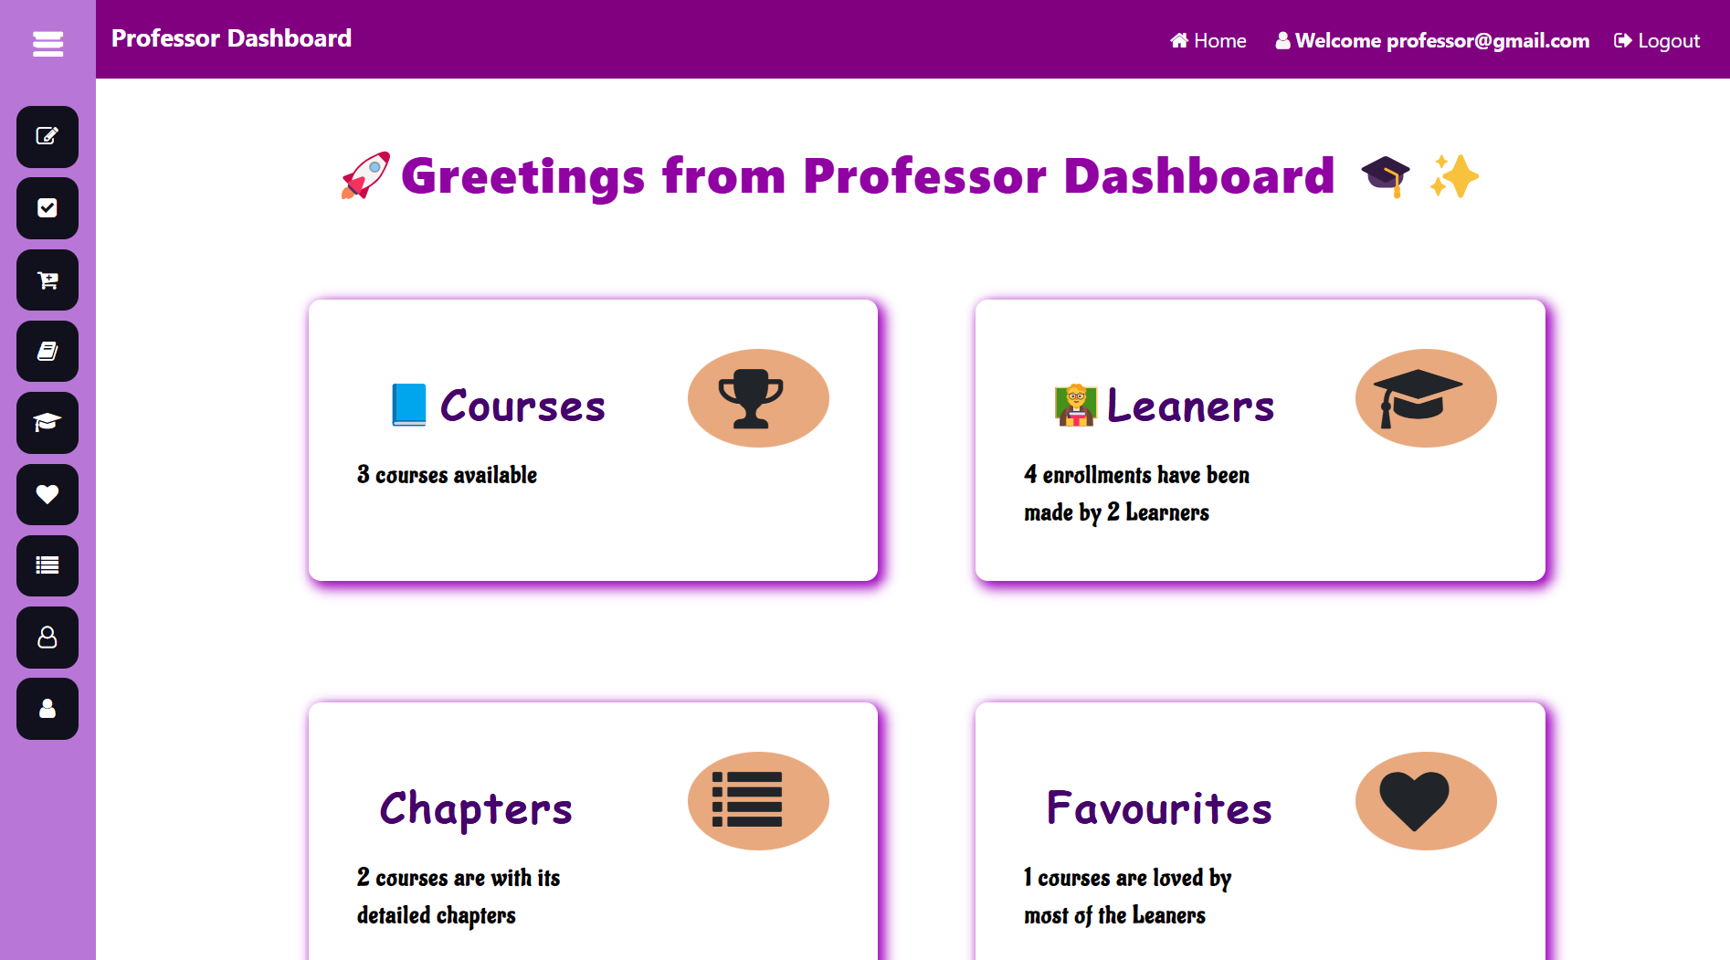

Slide 19

Conclusion
The E-Learning Platform Project has been a resounding success, delivering a comprehensive and engaging learning experience. We are committed to continually improving and expanding the platform to meet the evolving needs of learners and educators.

Slide 20

Thank You!
We appreciate your time and feedback.
We are excited to continue developing this platform and making it the best learning experience possible.

